Slide 1
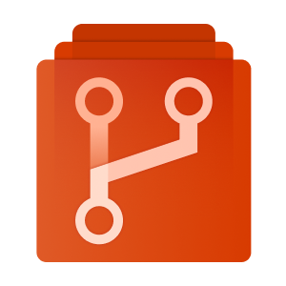

Variable storage solution for Deployment systems
Deployment
Azure Git Repos for storing JSON environment configuration
Azure Keyvault for storing sensitive variables
Secret Key retrieval Based on Deployment Environment Name This would allow multiple secrets based on Environment DEV_PWD DEV_SSL DEV_RSA Transposes the tokens for ${keyvault} from the config store
master.json
{
"installLocation": "d:\\apps",
"dbServer": "db01.${env}.internal.example.com",
"databaseLocations": "1433"
}
Pull JSON configuration from GIT Repo with merge down for master.json then db.json etc…. All ${env} tokens get replaced pre deployment with environment tags This would work for Application configuration as well
db.json
{
"internalzone": "${env}.internal.example.com",
"databaseName": "mydb-${env}",
"databaseMdfLocation": "d:\\${env}_SQL_data",
"databaseLdfLocation": "d:\\${env}_SQL_Logs",
"dboUser": "myuser-${env}"
"dbopassword": "$(keyvault)"
}
Resultant JSON config ready for deployment
{
"internalzone": "DEV.internal.example.com",
"databaseName": "mydb-DEV",
"databaseMdfLocation": "d:\\DEV_SQL_data",
"databaseLdfLocation": "d:\\DEV_SQL_Logs",
"dboUser": "myuser-DEV"
"dbopassword": "***",
"installLocation": "d:\\apps",
“dbServer": "db01.DEV.internal.example.com",
"databaseLocations": "1433"
}

